Slide 1
History

Slide 2
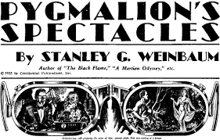
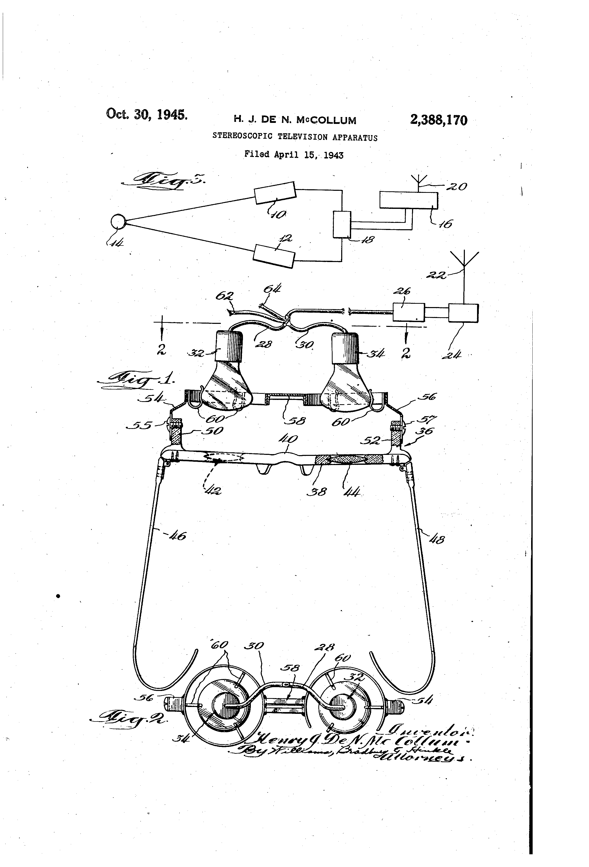
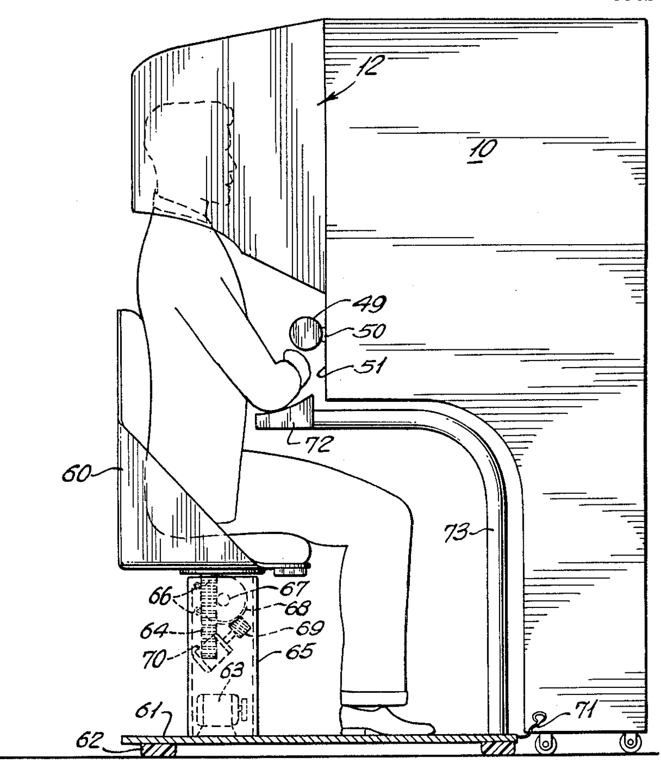
1930s - Stanley G. Weinbaum
First proposed the idea of VR
1955 – Morton Heilig
Envisioned multi-sensory theatre
1960 – Morton Heilig
Patented design for first head mounted display

Slide 3
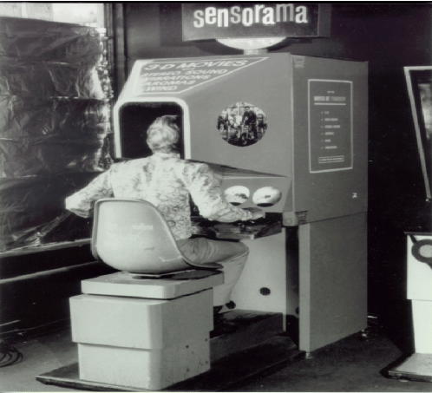
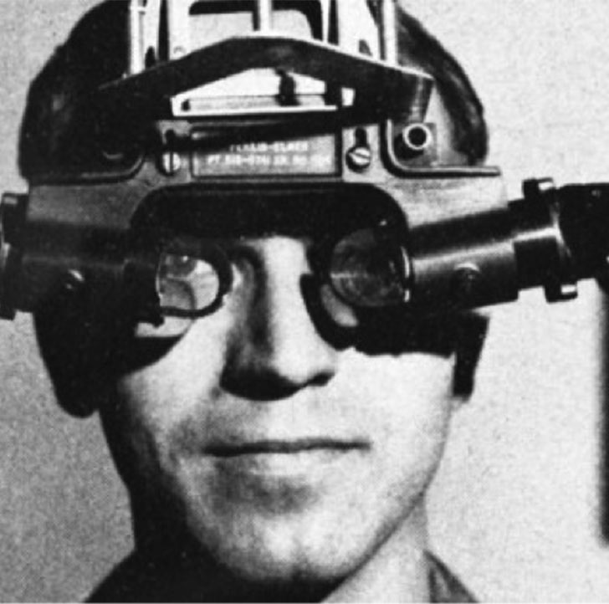
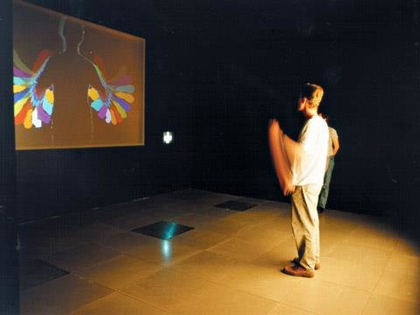
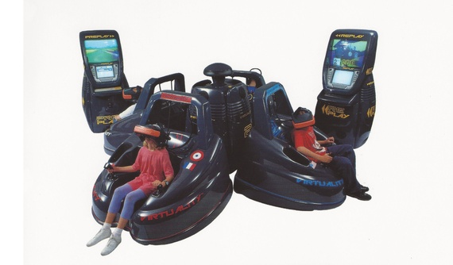
1962 – Morton Heilig
Created Sensorama
1965 – Ivan Sutherland
The Ultimate display
1970s – Myron Krueger
Created VideoPlace
1991 – Virtual Group
Vr arcade games

Slide 4
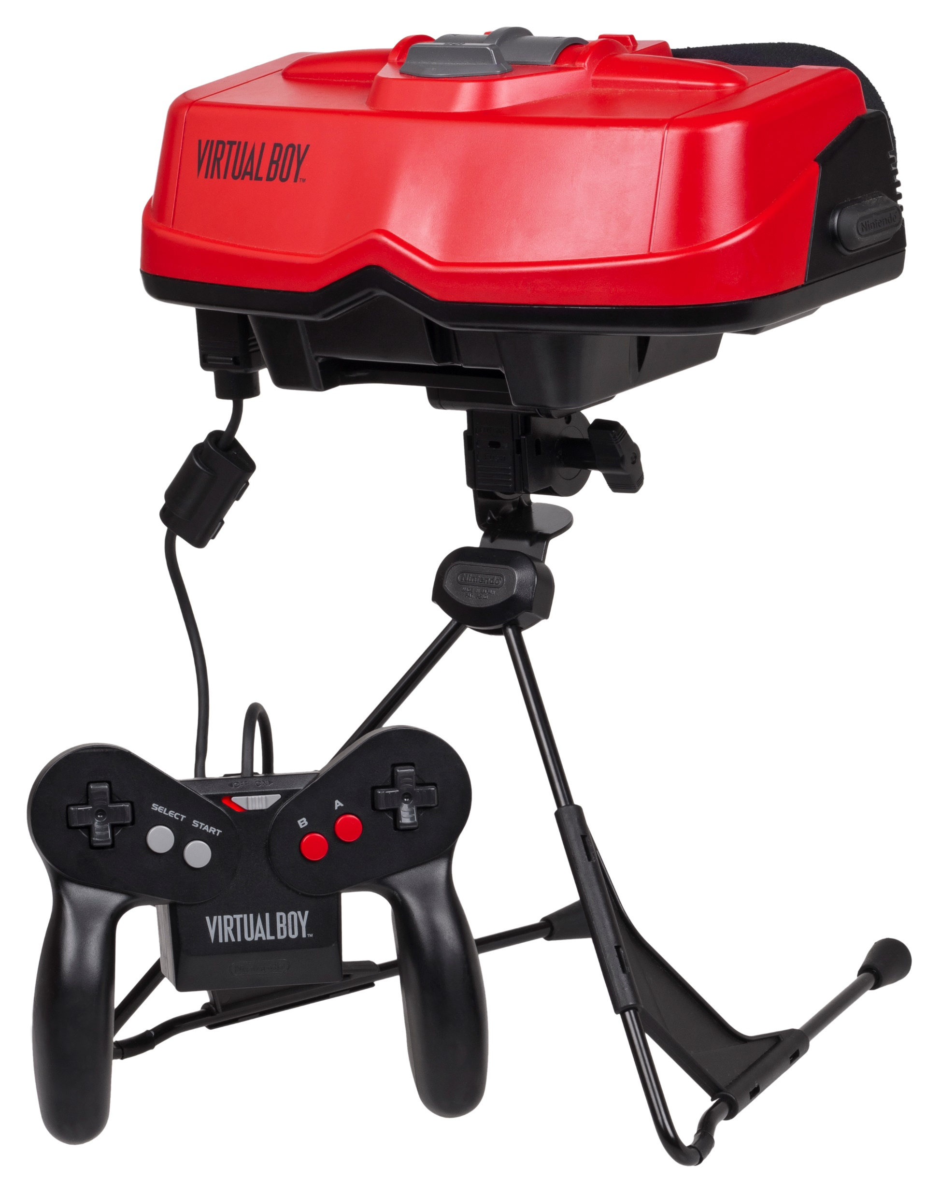
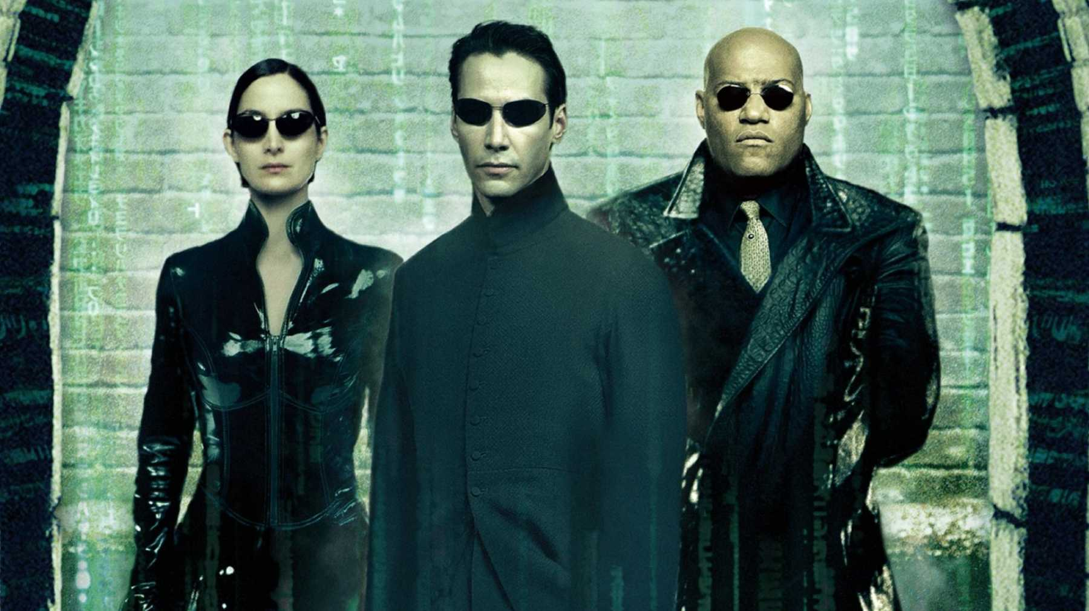
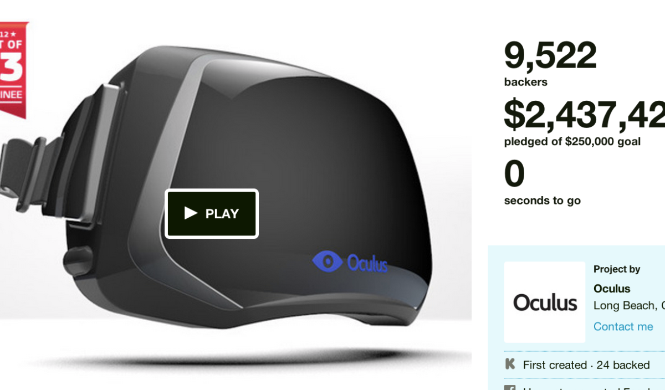
1995 – Nintendo Visual Boy
Head mounted dispay
1999 – The Matrix
Inspired many to invest in VR
2012 - Oculus

Slide 5
Future

Slide 6
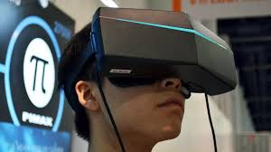
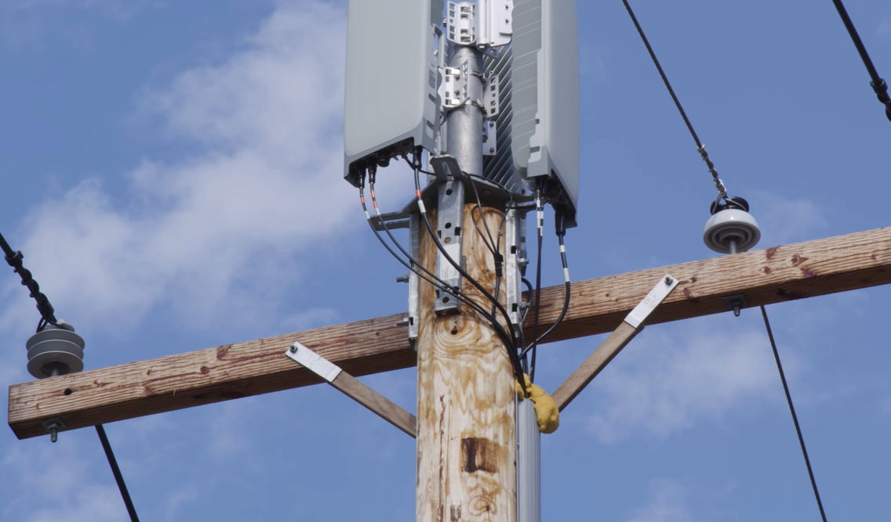
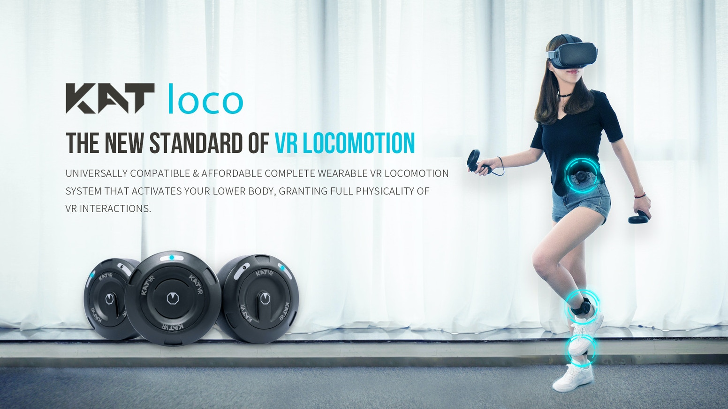
Pimax 8k Headset
Provides a more captivating experience, but requires a very powerful processor.
Development in 5G
VR could potentially receive images in real time
KAT VR
Complete control over lower body

Slide 7
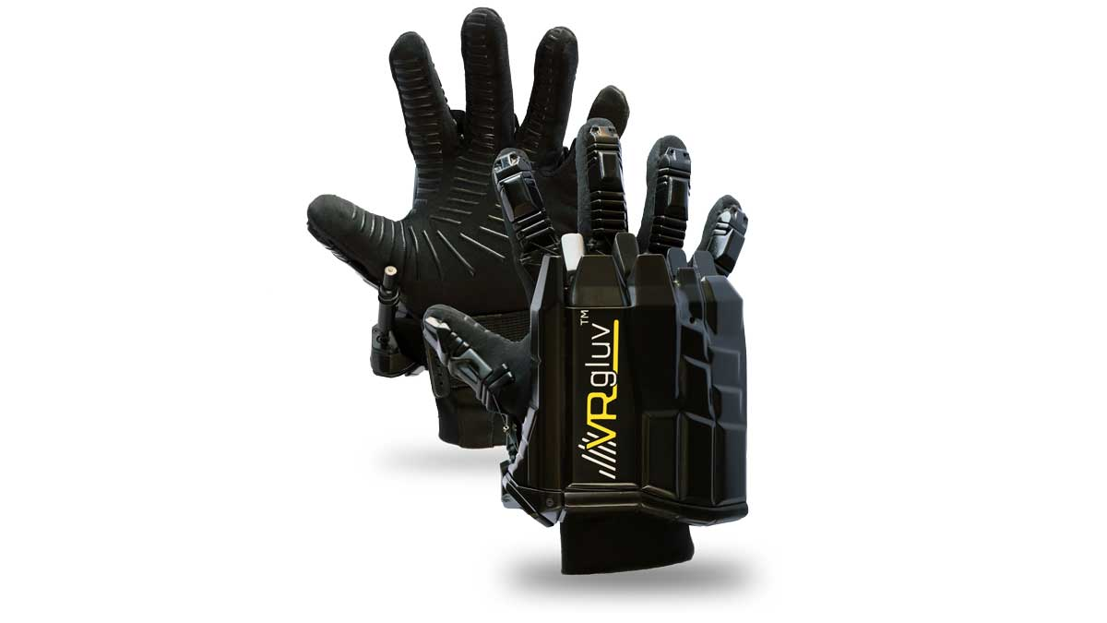
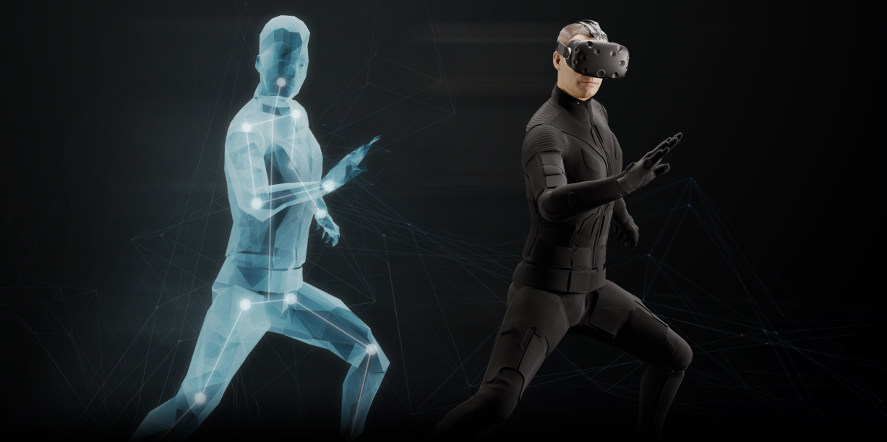
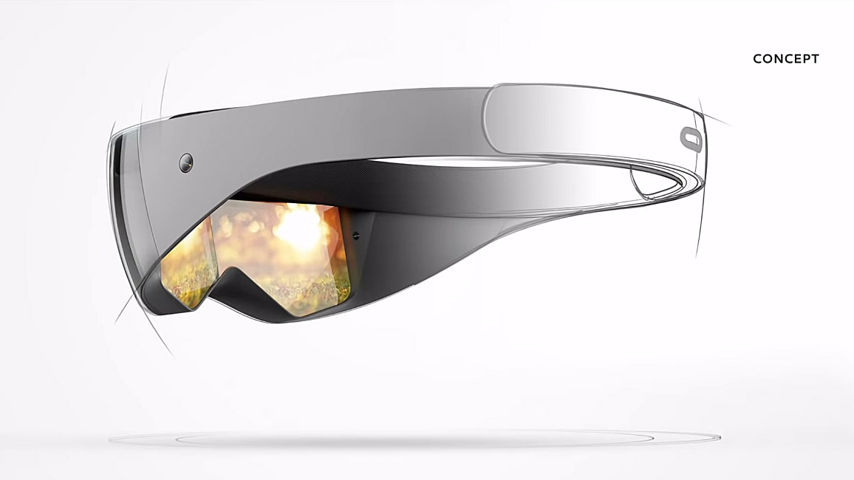
Vr Gluv
Haptic gloves
Tesla Suit
Full body haptic suit, not easily available to the public yet
Future VR headset
It is hoped that VR headsets will be light and easy to ignore when wearing them.

